Slide 1
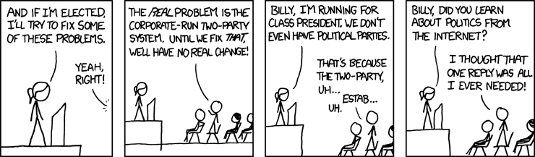

Welcome back!
The Final Studio, S13
Ma Chi Kin Brian
e1121386@u.nus.edu
Tele: @bmanara

Slide 2
Finals are approaching…

Slide 3
Agenda for Today
Admin Matters
Recap
End of CS1101S…
No Studio Worksheet LETS GOOOOOOOOOOOOOOOOO

Slide 4
Admin Matters
Course Feedback
Remember to do the feedback for CS1101S!
Finishing the feedback will help with tiebreakers during CourseReg next Semester
Source Academy XP
Anyone still not at the required XP benchmark?
Over the study break, you can still ask me questions regarding Finals, but do understand that I am also preparing for my finals…

Slide 5
RECAP
Types
Classes & Objects

Slide 6
Recap
Sike, there is no recap…
But… I did make the slides, I didn’t realise that Types, Classes & Objects are Bonus Topics.
Either way, I’ll still upload the slides if you’re interested

Slide 7
Types
We have already seen many types in CS1101S…
Numbers
Strings
Booleans
Functions… etc.
We do different kinds of operations on different types.
Say a square(x)function… It expects a number and returns a number.
Passing a string to the above function doesn’t really make sense… But our program will still try and run it, before giving us some error. There has to be a better way right?
Notes:
Note that in Source, we vaguely describe our integers, floats, doubles as just “numbers”
The error we talk about in this slide can be considered as a “runtime error”... Our program only knows there is an error when we try and run it!
Source is “weakly-typed”, like how JavaScript is. Not all languages are “weakly-typed” though, Java is “strongly-typed”!

Slide 8
Types
Checking if our program is correct
We know that names must be declared before programs are run
Similarly, types allow us to check before running the program that:
All functions are applied to values of permissible types
Type Errors are thrown when we do type checking.
Type checking is done before running the program in this Typed Variant of Source.
Notes:
Instead of checking during “runtime”, we check before we even run the program!

Slide 9
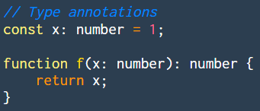
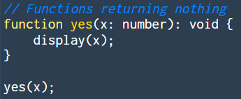
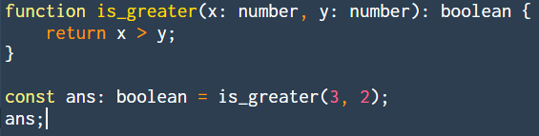
Source S1 Typed
Type Annotations (Constant & Function Declarations)
Notes:
For those familiar with Java (or any strictly types languages)... It’s very similar, just syntactically different.

Slide 10
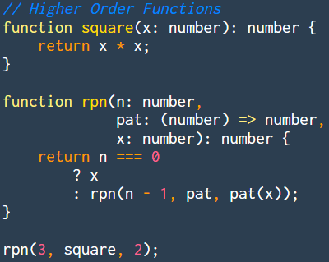
Source S1 Typed
Higher Order Functions
Notes:
For those familiar with Java (or any strictly types languages)... It’s very similar, just syntactically different.

Slide 11
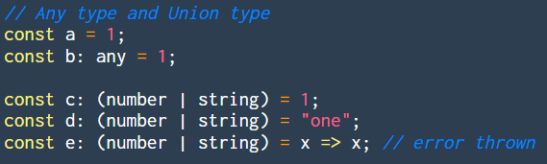
Source S1 Typed
Any Type & Union Type

Slide 12
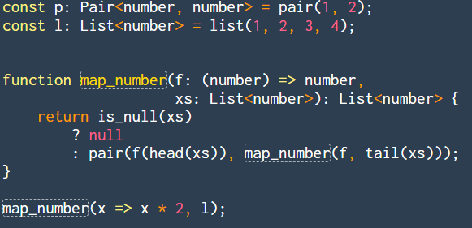
Source S2 Typed
Type Annotations (Pairs and Lists)

Slide 13
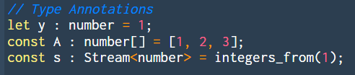

Source S3 Typed
Type Annotations (Variables, Arrays and Streams)

Slide 14
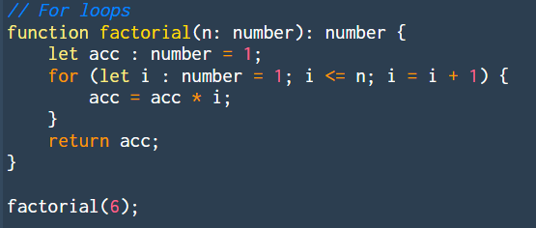
Source S3 Typed
Example: for Loops

Slide 15
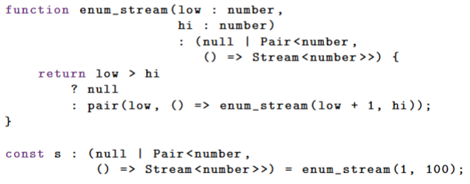
Source S3 Typed
enum_stream implementation…

Slide 16
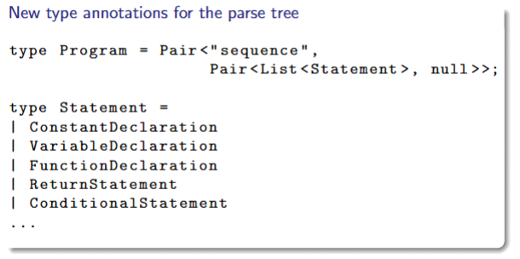
Source S4 Typed
More details at https://docs.sourceacademy.org/source_4_typed.pdf

Slide 17
Summary of Types
Ability to add type annotations on our functions and constant/variable declarations!
Allows us to catch programming errors before the program runs.
Usefulness of this is more apparent in future mods…
Only supported in Type Variants of Source, and type annotations are optional!
Sneak Peek into CS2030S, working with Java, a strongly-typed language…

Slide 18
Classes & Objects
Classes
A blueprint for creating objects
Defines the attributes and methods/functions that the objects created will have
Objects
Built from a class
We call this creation “instantiation”
We instantiate an object from a given class
The object has its own data, but shares the general structure and functionality that was defined from its class

Slide 19
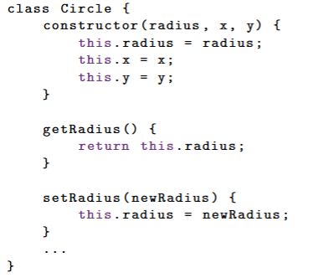
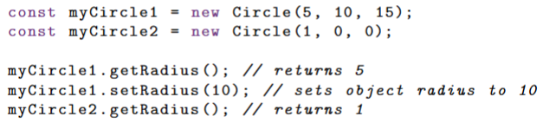
Classes & Objects
JavaScript Code:
Constructor, what does it do?
Accessing the properties and methods?
How to instantiate?

Slide 20
Summary
Classes allow us to combine functions and data together
Objects are an instance of a class.
This type of programming is known as OOP Object Oriented Programming.
Implementation of this in Source is… Not great, since it is a mostly functional programming language
Refer to the lecture slides for the implementation of it in Source!
More about this in CS2030S!

Slide 21
And… that’s it!
You’ve completed CS1101S! (well… there’s still finals)

Slide 22
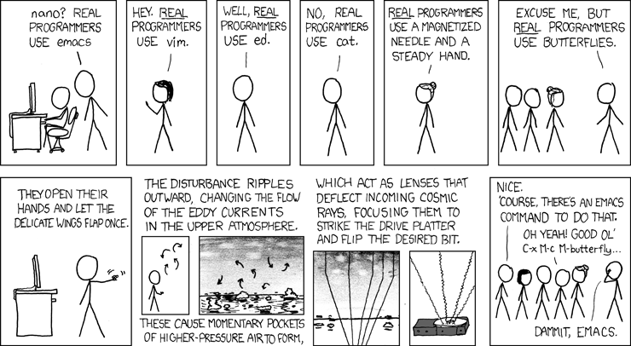
Looking ahead…
One semester down, 7-ish more to go!

Slide 23
If you’re interested…
Here’s my socials, connections are important in University
Instagram: @bmanara (some of yall already follow me…)
GitHub: @bmanara
All the code and slides I used in Studio can be found here too
https://github.com/bmanara
LinkedIn: https://www.linkedin.com/in/brian-ma-a0713a25a/
Gotta be professional, hence my LinkedIn :)))

Slide 24
See you next week around?
All the best for your future endeavours!

